Slide 1

MATLAB Implementation of Simple Linear Regression and KNN
Professor Bo Liu
James Watt School of Engineering

Slide 2
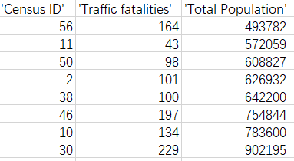
MATLAB implementation of simple linear regression
The traffic accidents dataset
Data on US traffic accidents and fatalities in 2004 from the US Department of Transportation.
It has 51 samples.
Our aim is to find the relationship between the population and the number of fatal accidents.

Slide 3
MATLAB implementation of simple linear regression
1. Load data
load accidents
x = hwydata(:,14); %Population of states
y = hwydata(:,4); %Accidents per state
format long;
2. Linear regression without intercept
a1 = x\y
The \ operator performs a least-squares regression.
a1 = x\y is used to find the linear regression relation $y=a_{1}x$
See live script

Slide 4
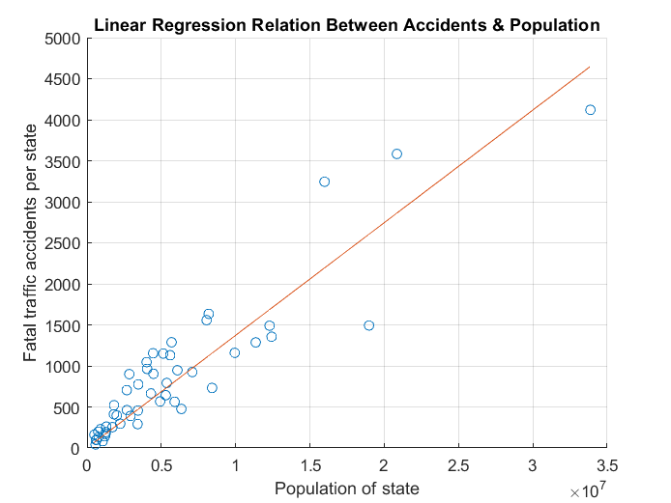
MATLAB implementation of simple linear regression
3. Prediction and visualize
yCalc1 = a1*x;
scatter(x, y);
hold on;
plot(x, yCalc1);
xlabel('Population of state');
ylabel('Fatal traffic accidents per state');
title('Linear Regression Relation Between Accidents & Population');
grid on;
The linear regression model $y=a_{1}x$, without intercept.
See live script

Slide 5
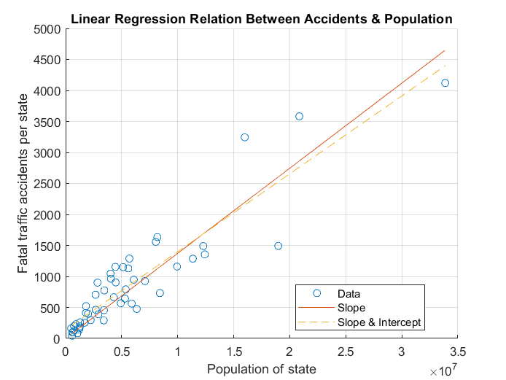
MATLAB implementation of simple linear regression
4. Linear regression with intercept
Linear regression:
X = [ones(length(x),1) x];
b = X\y;
Prediction and visualization:
yCalc2 = X*b;
plot(x,yCalc2, ’--’);
legend('Data’, 'Slope’, 'Slope & Intercept’, 'Location’, best);
The linear regression model with intercept $y=b_{1}x+b_{0}$

Slide 6
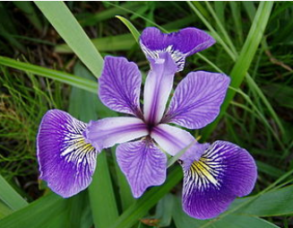
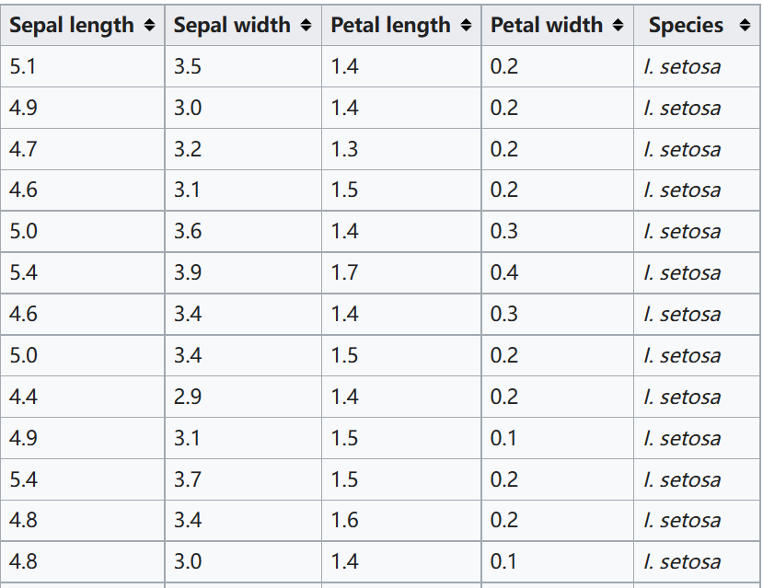
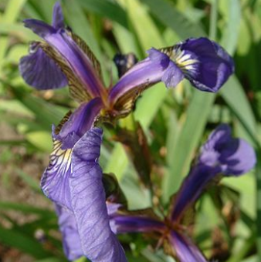
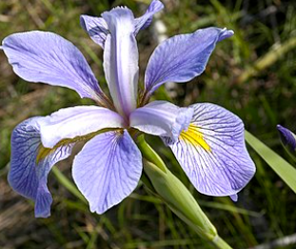
Iris flower classification by KNN using MATLAB
Iris flower classification problem
Features: (sepal length, sepal width, petal length, petal width)
Label: categorical, {setosa, versicolor, virginica}
Number of samples: 150
versicolor
setosa
virginica

Slide 7
Iris flower classification by KNN with MATLAB
1. Load data
load fisheriris;
X = meas;
Y = species;
2. Dataset split
Randomly split the data to the example set and the query set.
rp = randperm(length(Y));
X = X(rp,:); Y = Y(rp,:);
Example_X = X(1:100,:);
Example_Y = Y(1:100,:);
Query_X = X(101:150,:);
Query_Y = Y(101:150,:);
See live script

Slide 8
Iris flower classification by KNN with MATLAB
3. Model fitting
K=5;
model = fitcknn(Example_X, Example_Y, 'NumNeighbors', K);
4. Prediction
We use the model to predict the first three samples.
label_predicted = predict(model, Query_X(1:3,:));
{'setosa' }
{'virginica'}
{'setosa' }
The output:
See live script

Slide 9




Thanks!
#UofGWorldChangers
@UofGlasgow

